Slide 1
UI Basics, Terminologies and Tool Overview
Chapter 2

Slide 2
UI Basics
Web page consists: HTML, CSS, JavaScript
Content and Structure
Headline
Paragraph
No. of Paragraph
Style and Presentation
Font
Background
Formatting
Program the Behavior
User Interaction
Switch pages
Animations

Slide 3
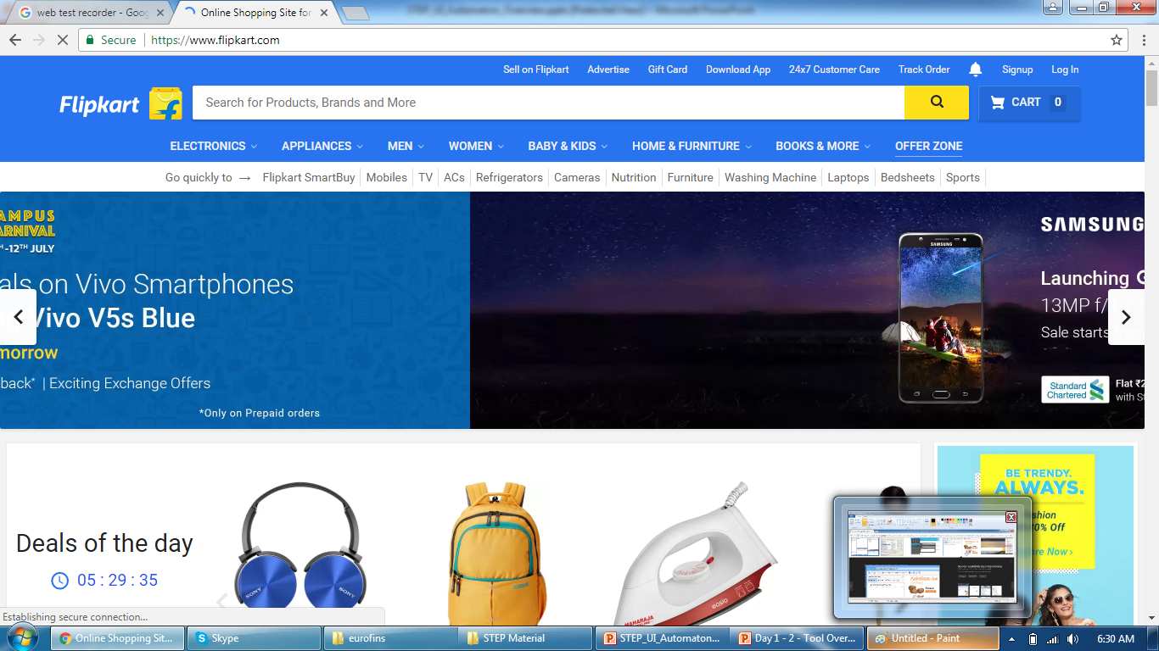
UI Basics
Including all of them, Page looks like this

Slide 4
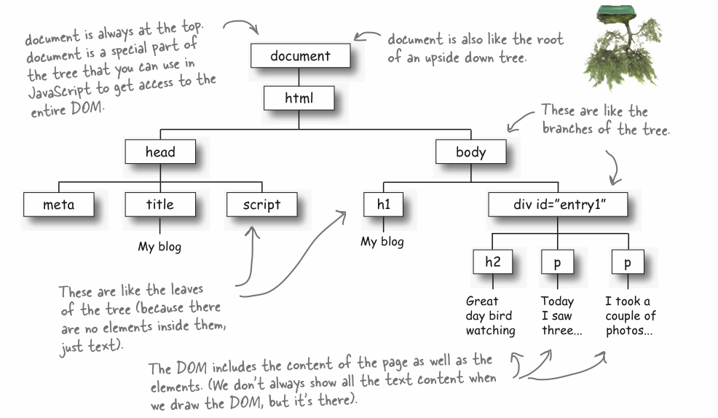
UI Basics
DOM (Document Object Model) structure

Slide 5

UI Basics
HTML tag

Slide 6
UI Basics
Head tag and their metadata, script, title

Slide 7
UI Basics
Body tag, head, paragraph

Slide 8
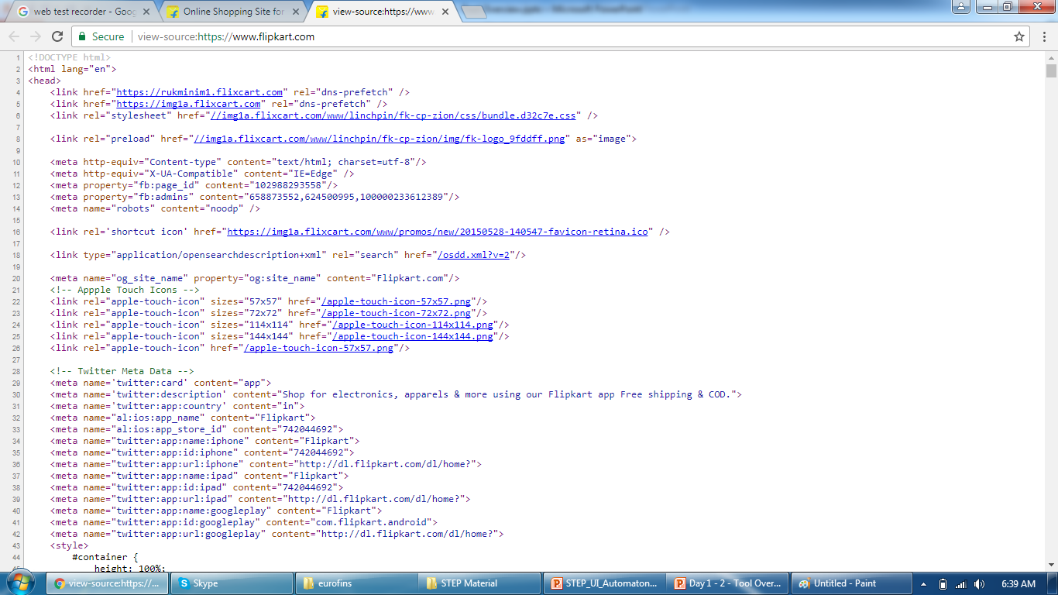
UI Basics
HTML, Head and meta tag

Slide 9
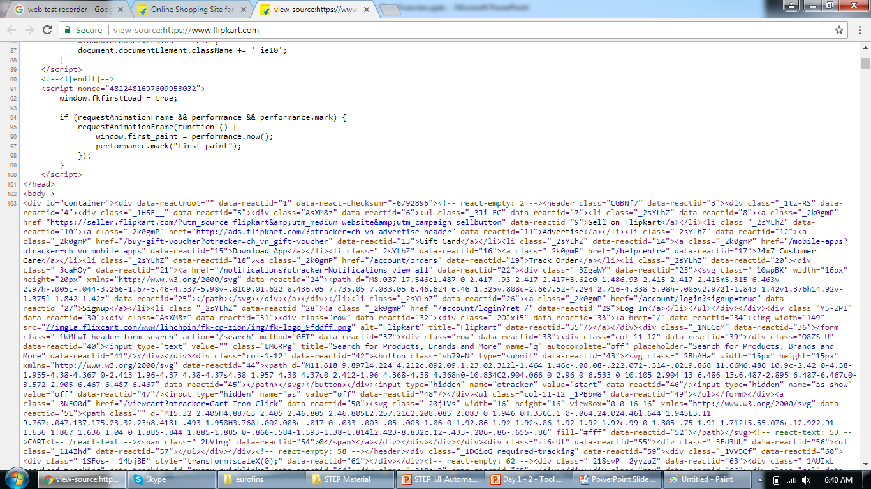
UI Basics
Body and Script tag

Slide 10
Web Page Response Code
102 Processing
2xx Success
200 OK
202 Accepted
206 Partial Content
3xx Redirection
301 Moved Permanently
304 Not Modified
4xx Client errors
400 Bad Request
404 Not Found
5xx Server error
500 Internal Server Error
503 Service Unavailable
100 Continue
1xx Informational responses

Slide 11
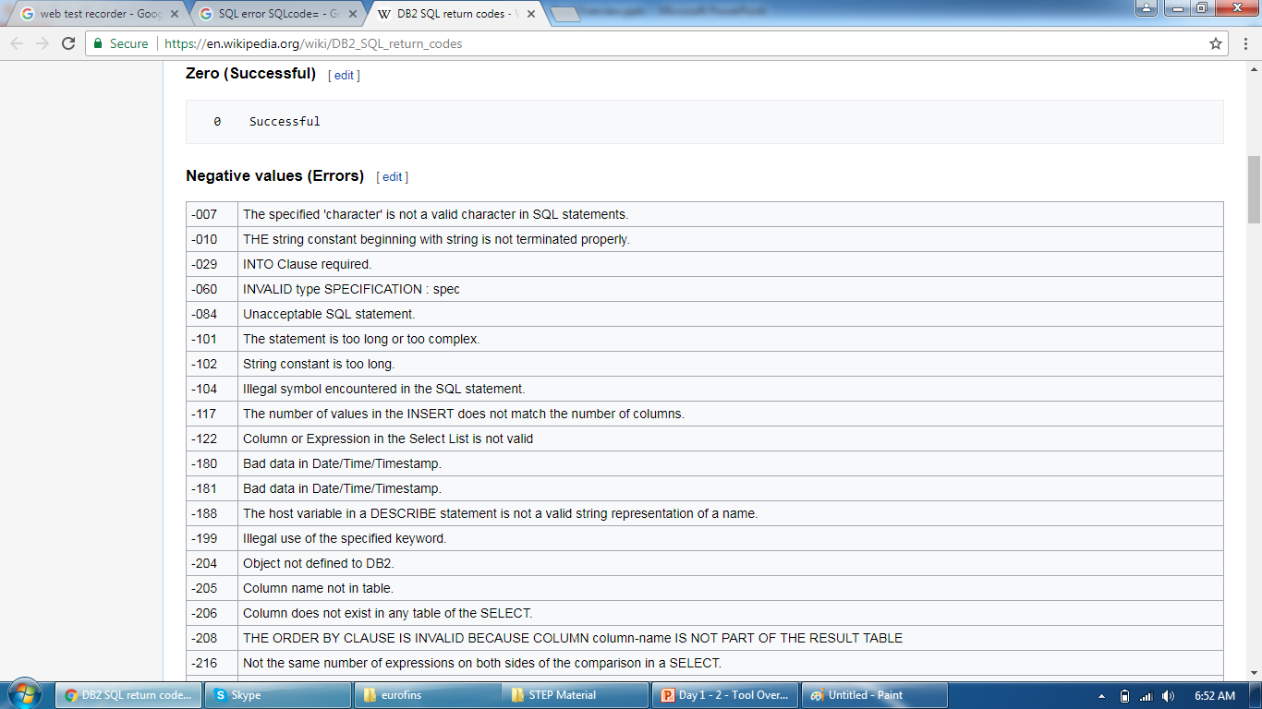
SQL Response Code
https://en.wikipedia.org/wiki/DB2_SQL_return_codes

Slide 12
Terminologies
Transactions
Every End User Step
Submit form, click button\link, refresh page
Parameterization or Data Binding
Feeding individual data for every user
Reusable data or destructive data
Correlations or Extractor
Need to authenticate request
Captured on previous screens
SessionID, VIEWSTATE
Text Checks or Validations
Functional verification
User does it visually locating messages
Run Time Settings
Number of Iterations
Think time
Browser
Cache

Slide 13
Tool Overview
Demo on VSTS

Slide 14
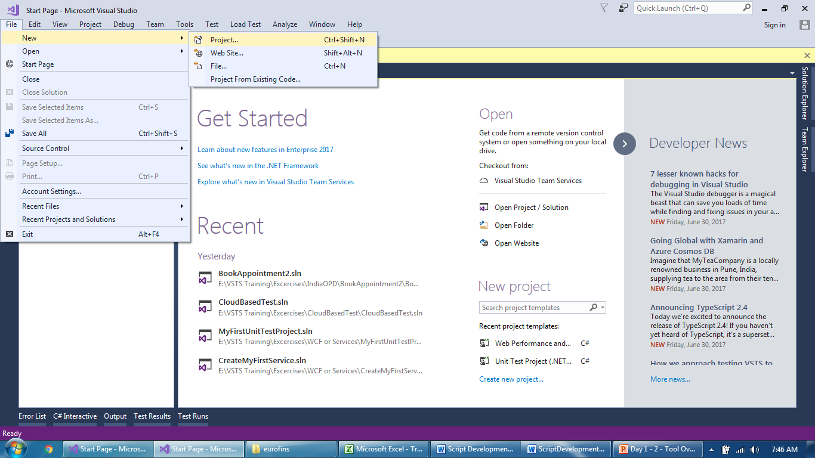
Tool Overview
Create new Web Performance Test

Slide 15
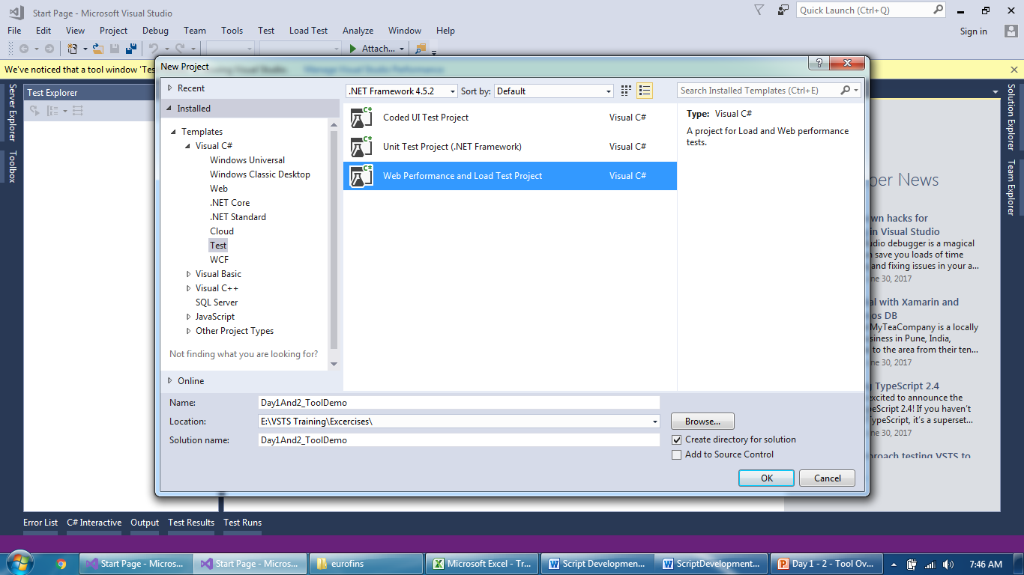
Tool Overview
Create new Web Performance Test

Slide 16
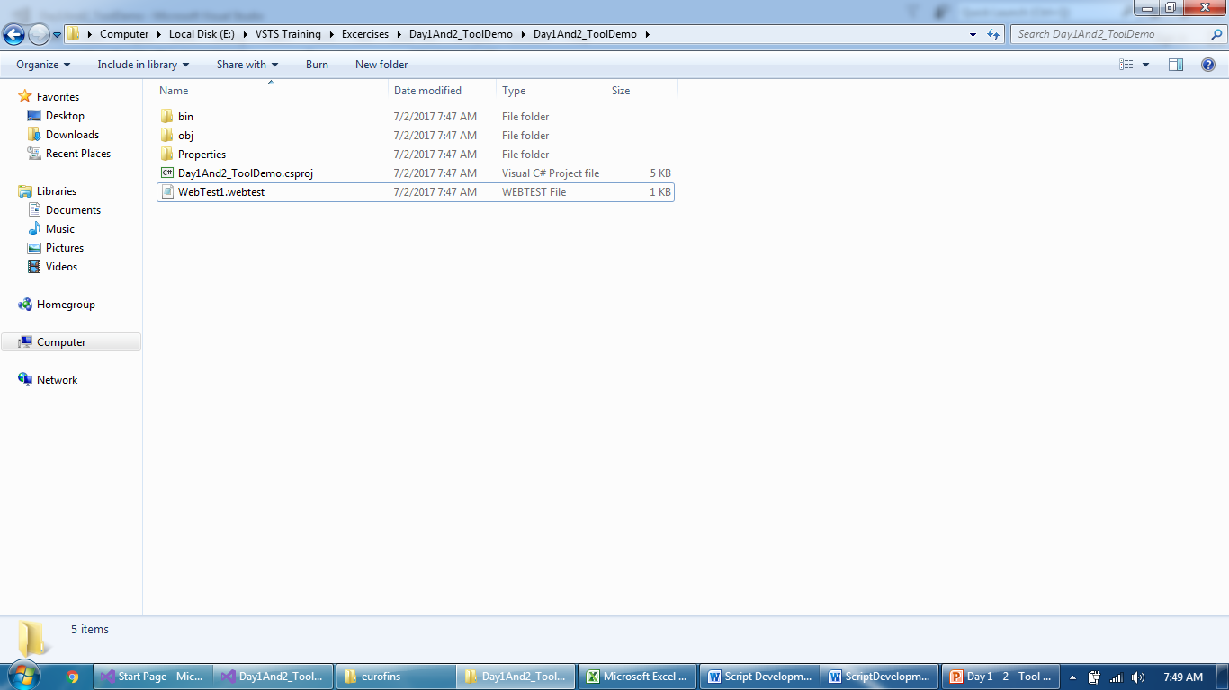
Tool Overview
Browse Folder location of .webtest file

Slide 17
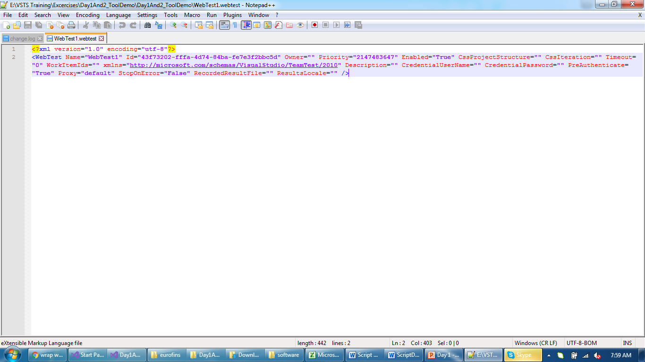
Tool Overview
How does a empty script look

Slide 18
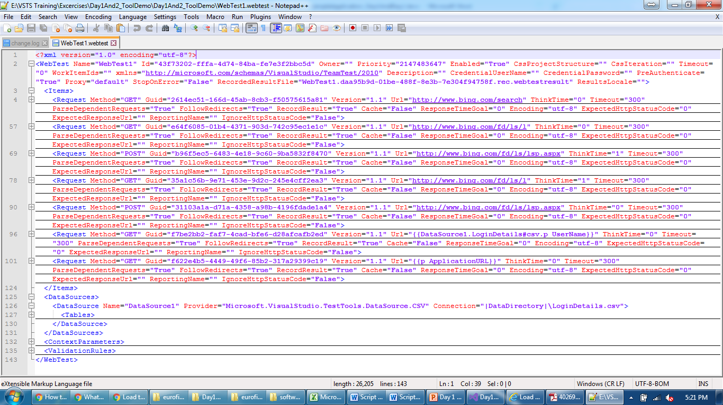
Tool Overview
How does a script with all elements (requests, data source etc)

Slide 19
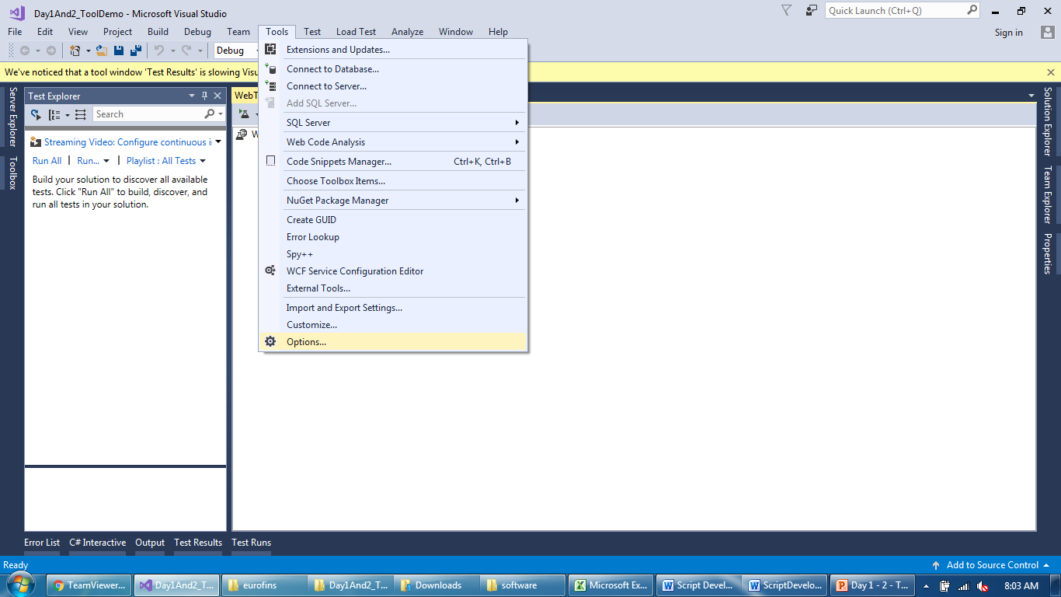
Tool Overview
Global settings for Web Performance Test

Slide 20
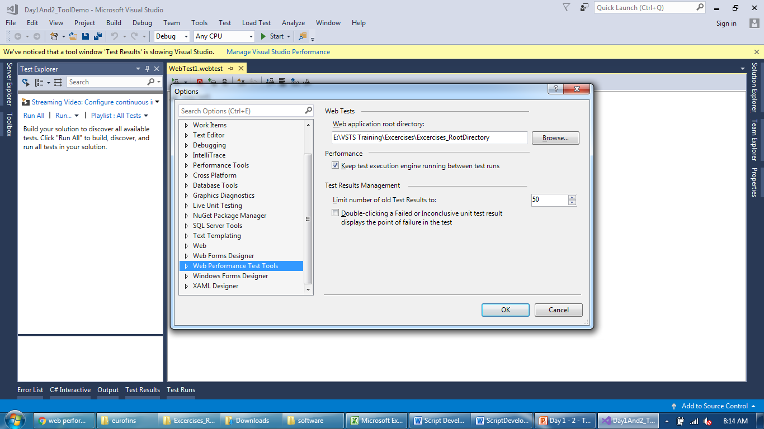
Tool Overview
Global settings for Web Performance Test

Slide 21
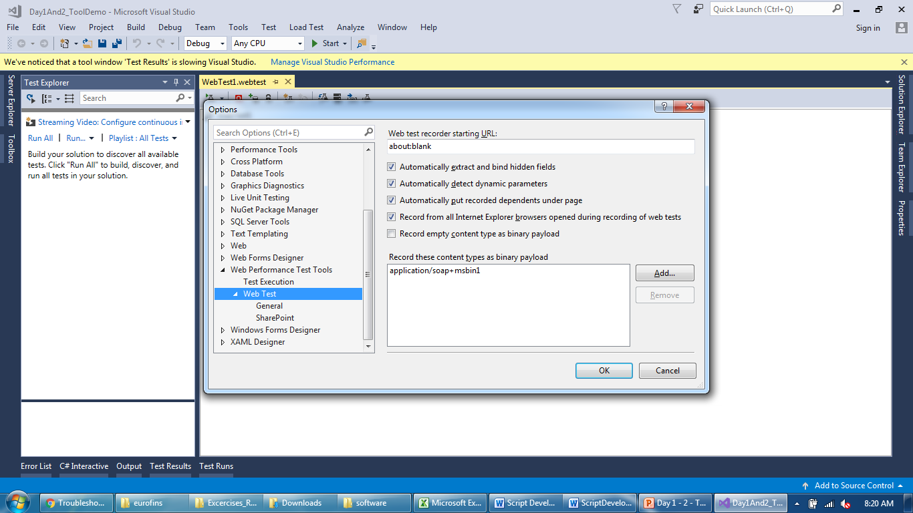
Tool Overview
Global settings for Web Performance Test

Slide 22
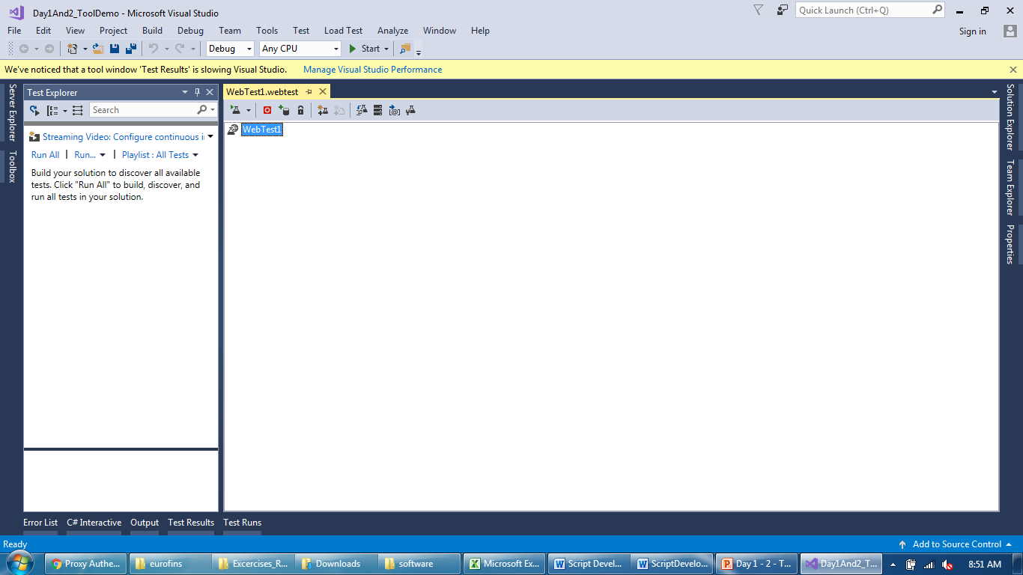
Tool Overview
A new empty script and all menu bar walkthrough

Slide 23
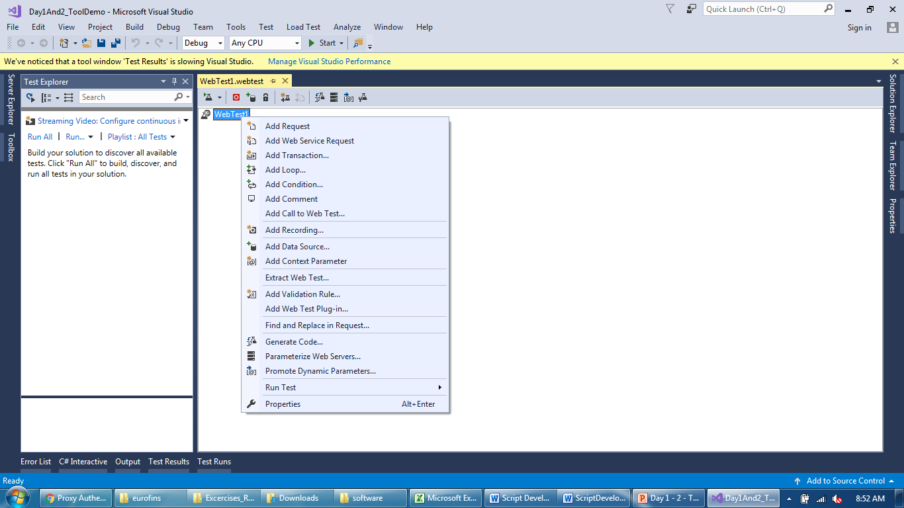
Tool Overview
Introduction to script Level menu bar

Slide 24
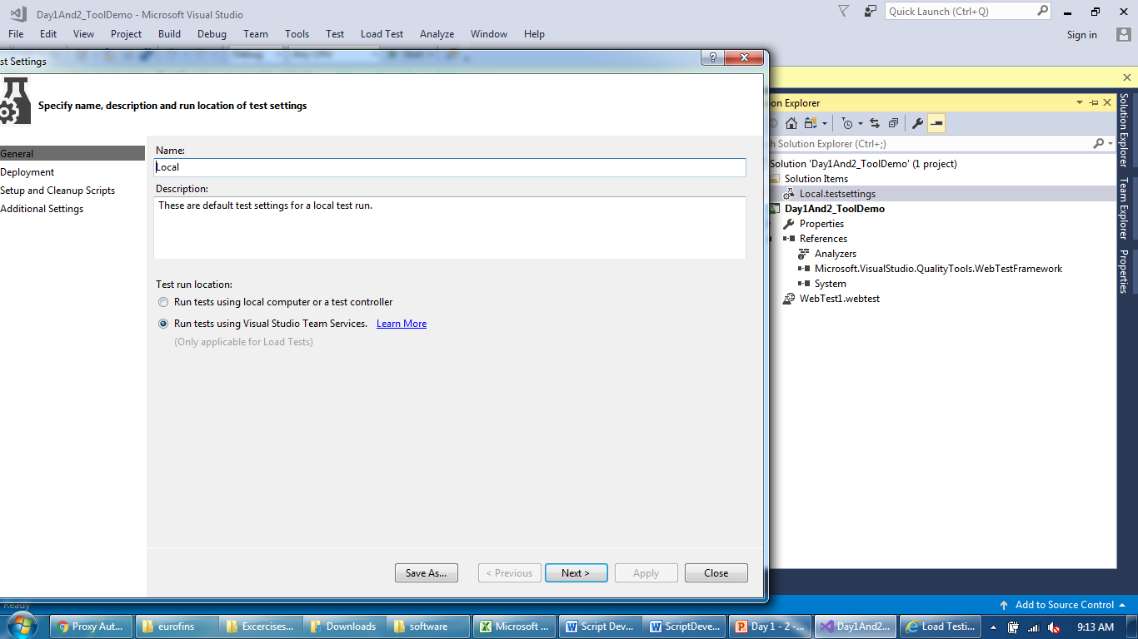
Tool Overview
Local Project Setting

Slide 25
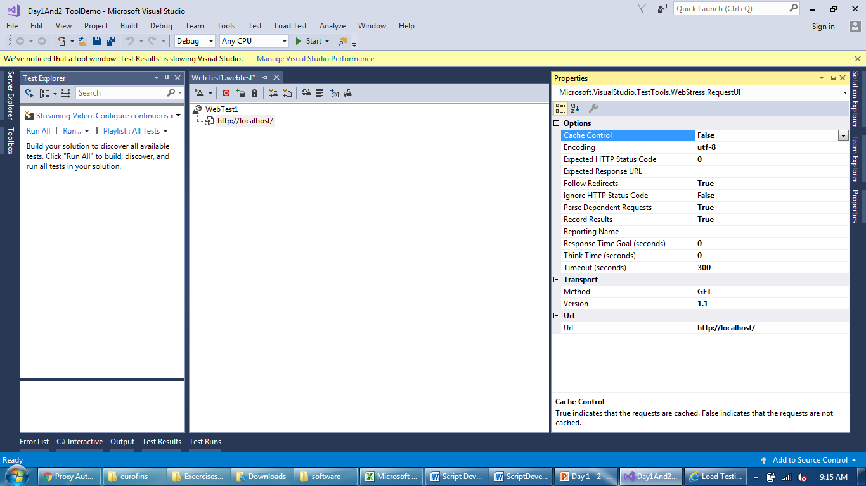
Tool Overview
Properties of request

Slide 26
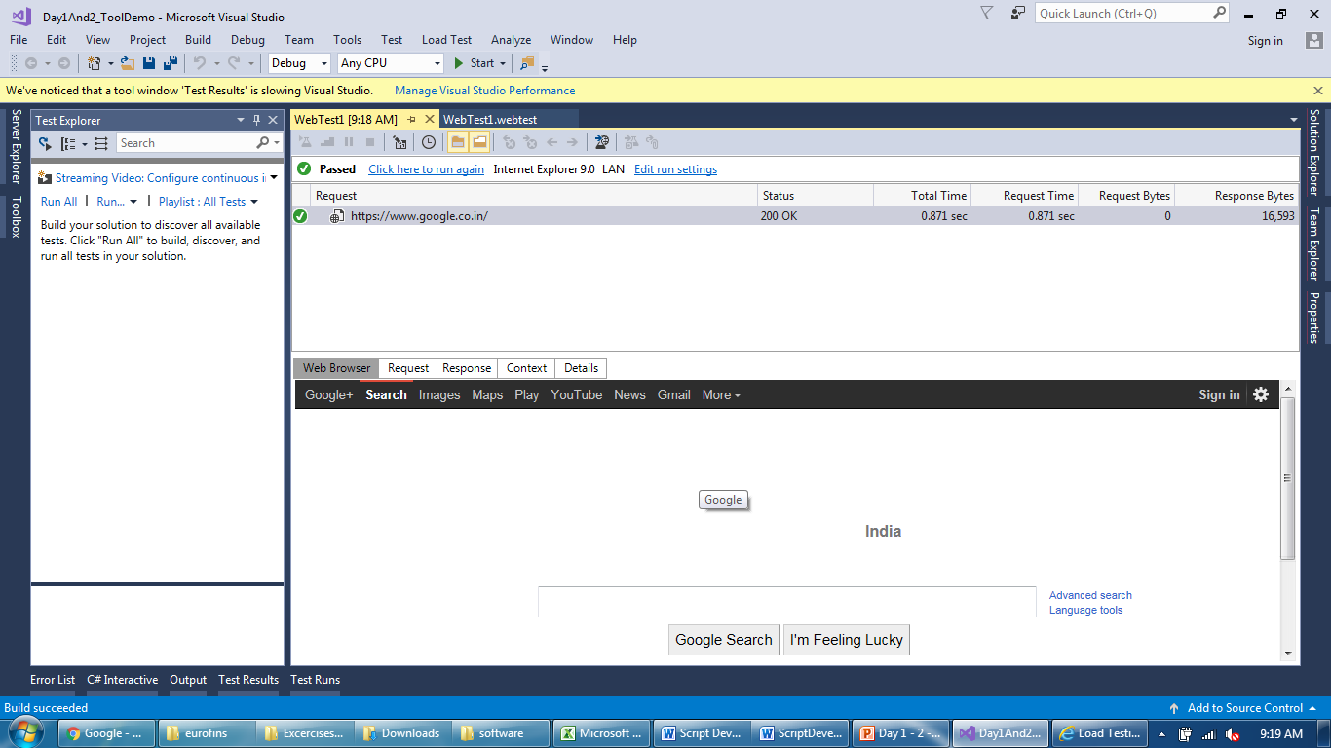
Tool Overview
Script replay results – Used for debugging the script

Slide 27
Tool Overview
Script replay results – Used for debugging the script

Slide 28
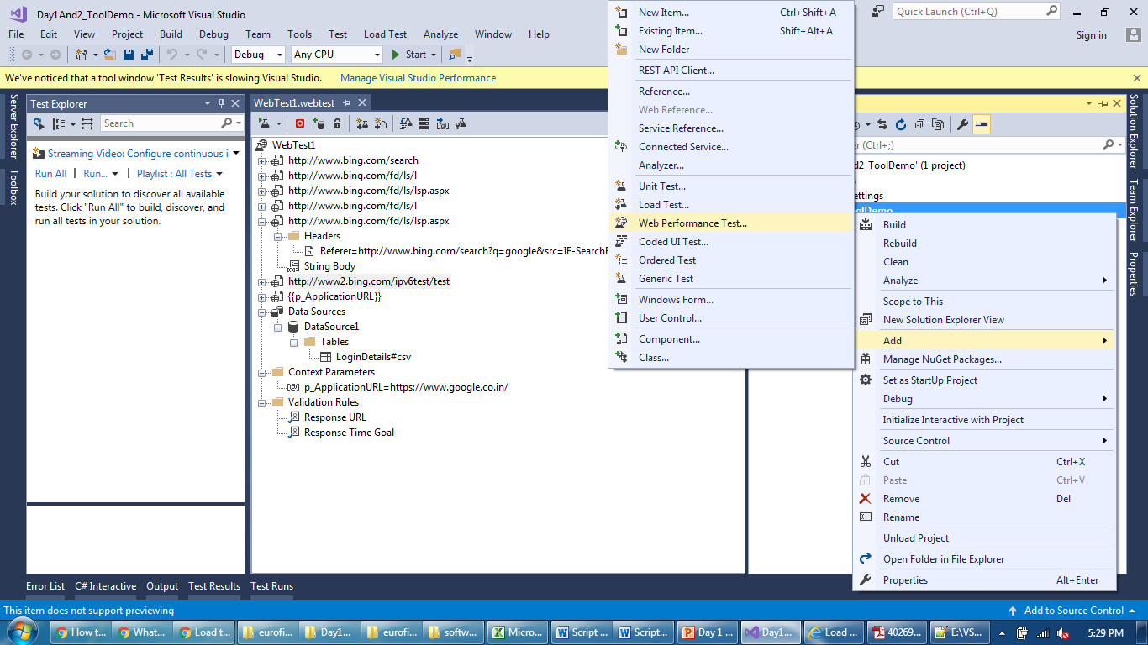
Tool Overview
Add more than one script in one project

Slide 29
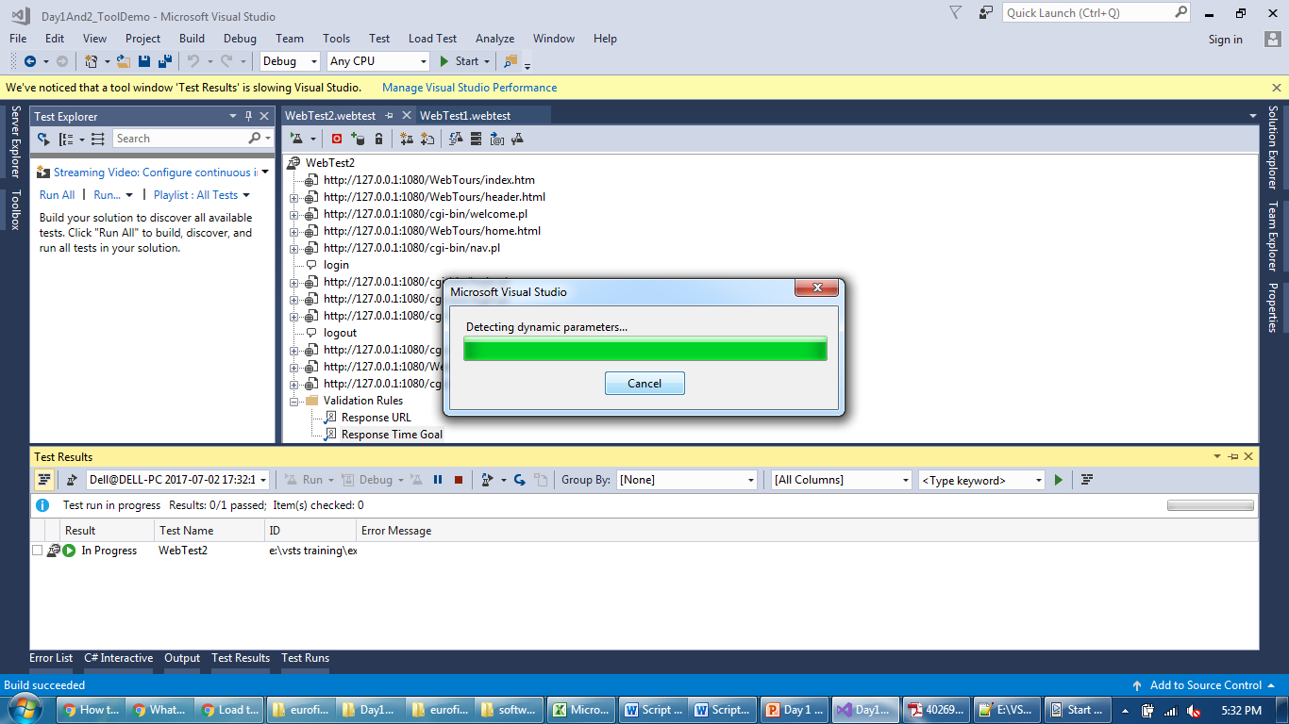
Tool Overview
Dynamic parameter detection after recording completes

Slide 30
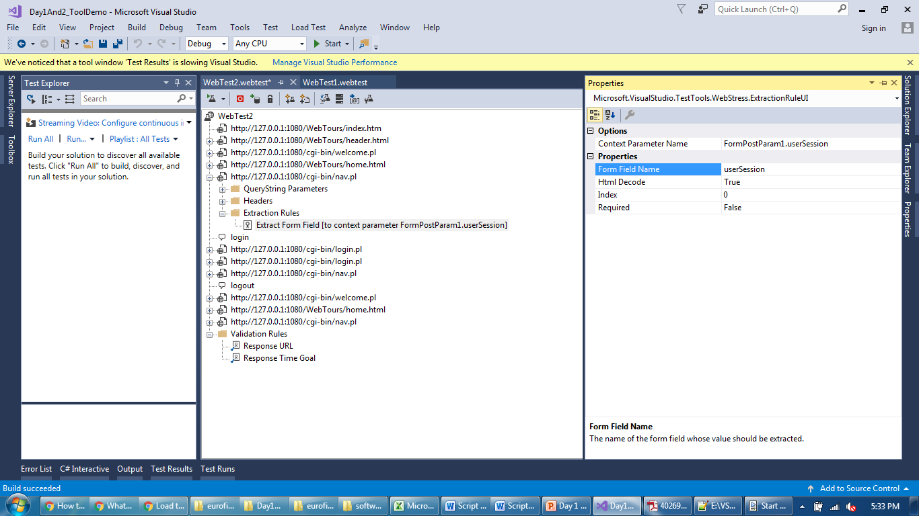
Tool Overview
Dynamic parameter detection after recording completes

Slide 31
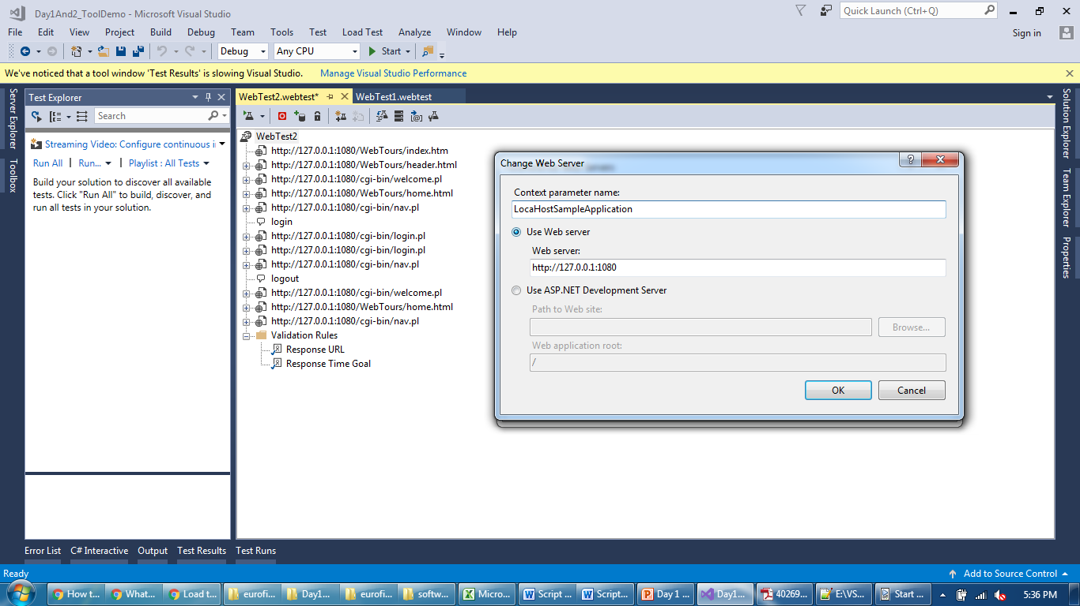
Tool Overview
Script parameterized with server host name

Slide 32
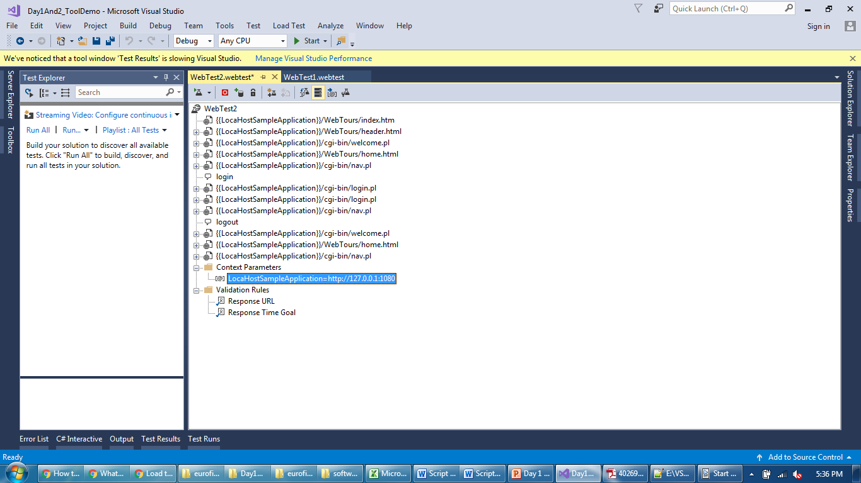
Tool Overview
Change web server nothing but context parameter

Slide 33
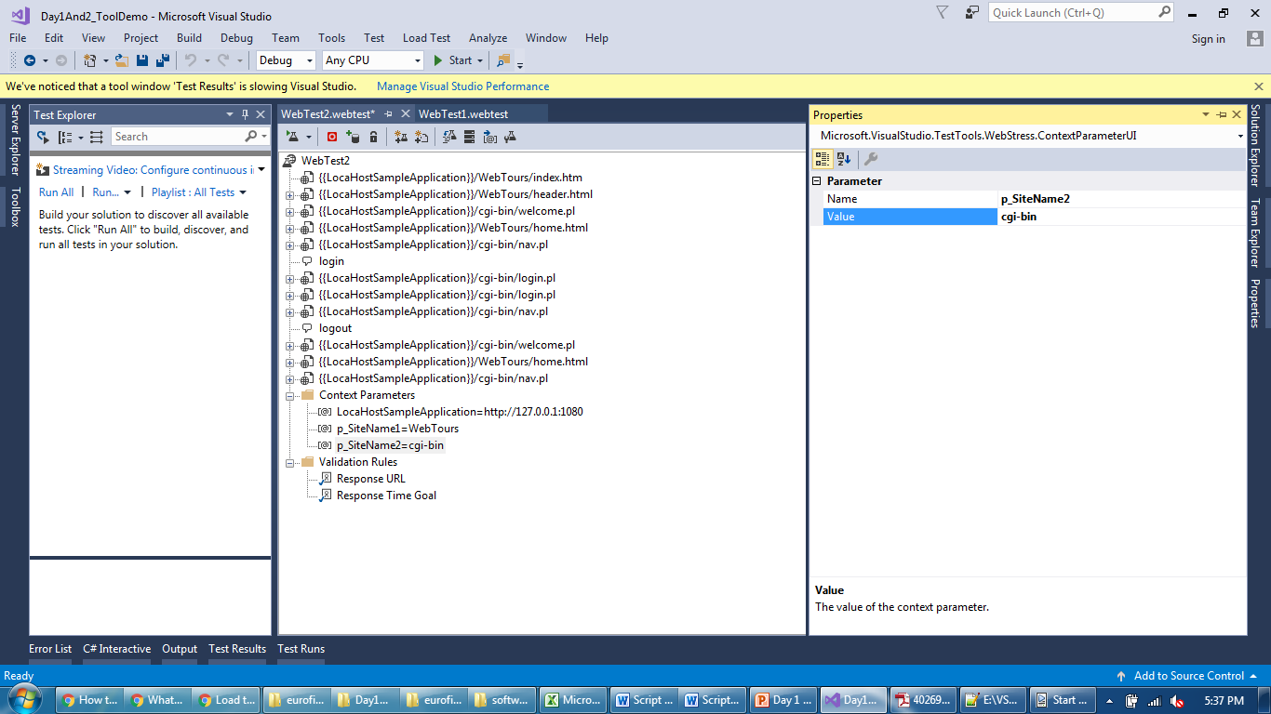
Tool Overview
You can also add Context Parameter explicitly

Slide 34
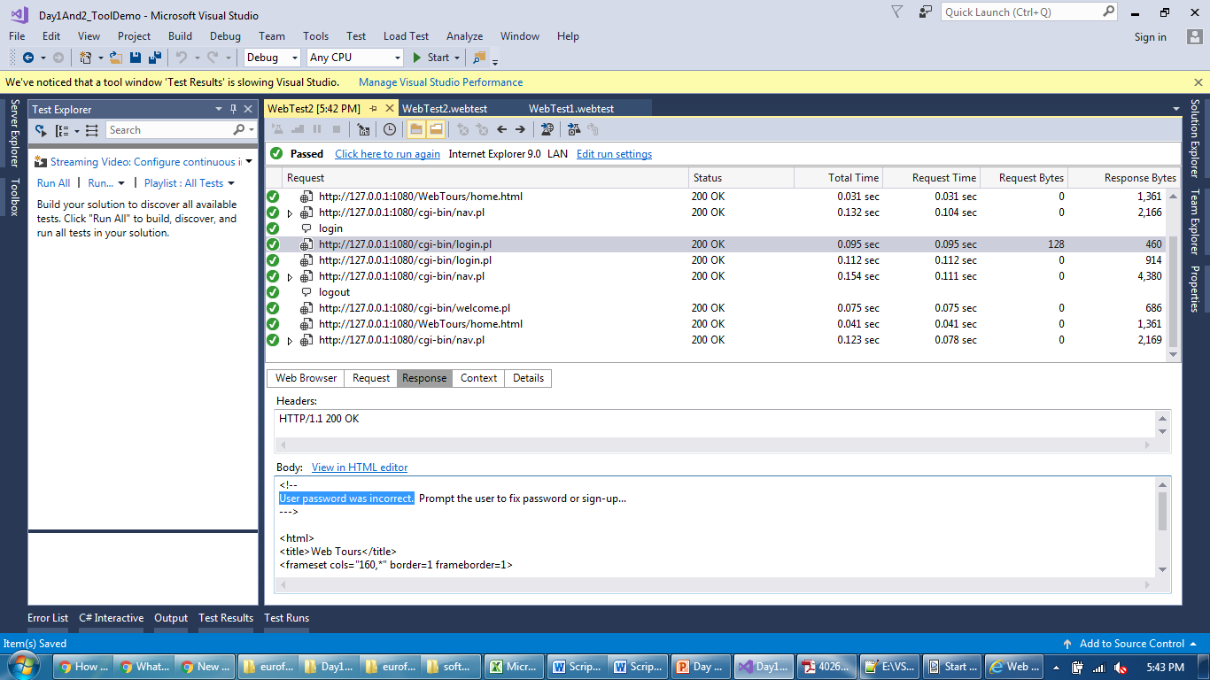
Tool Overview
Login failed but script passed, that’s why need validations

Slide 35
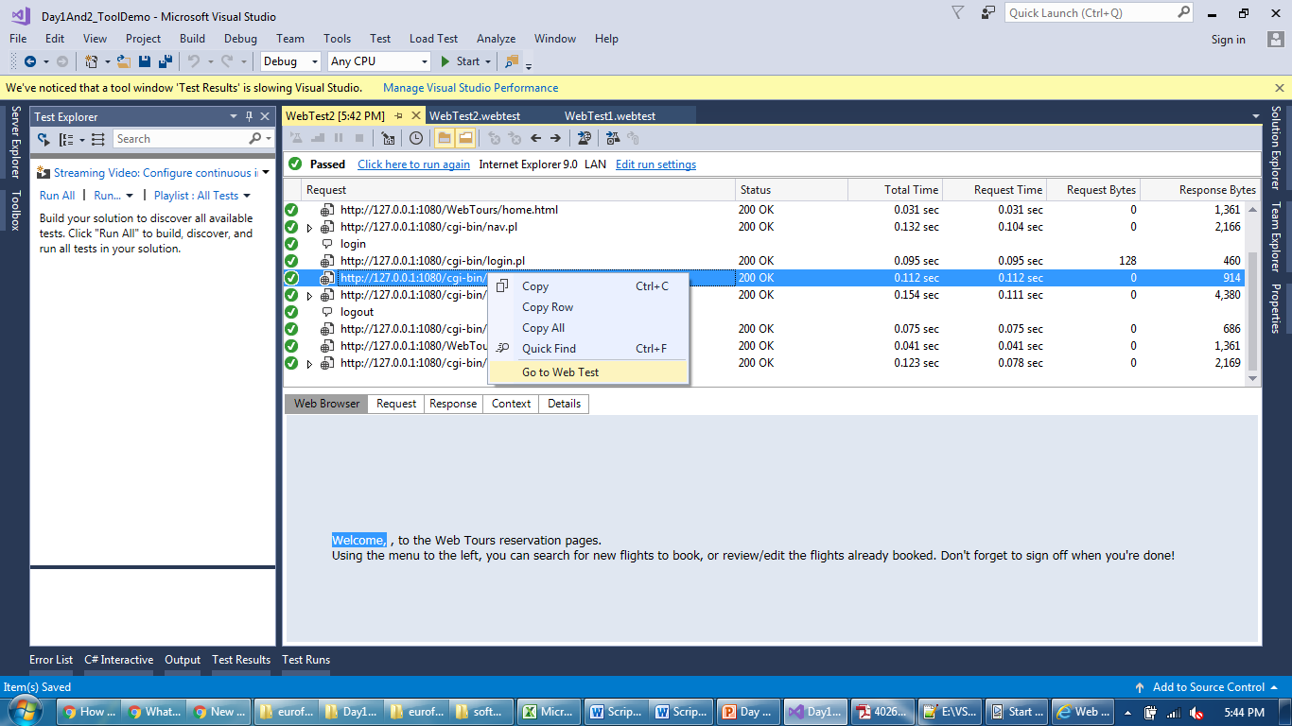
Tool Overview
Copy validation text and go to web test

Slide 36
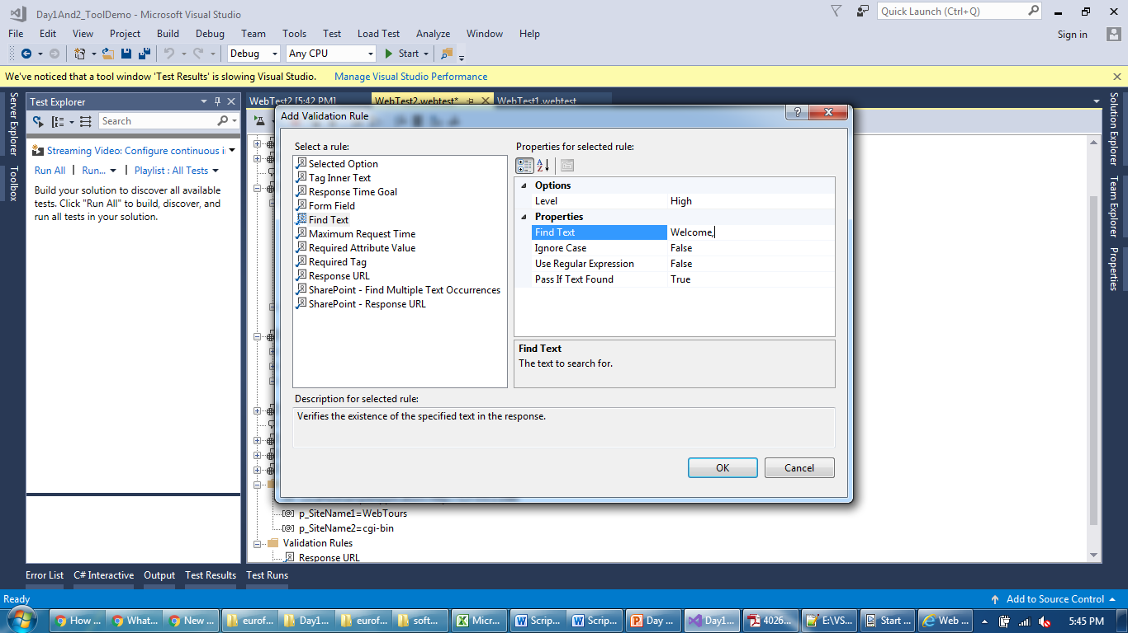
Tool Overview
Added “Exact Text” validations

Slide 37
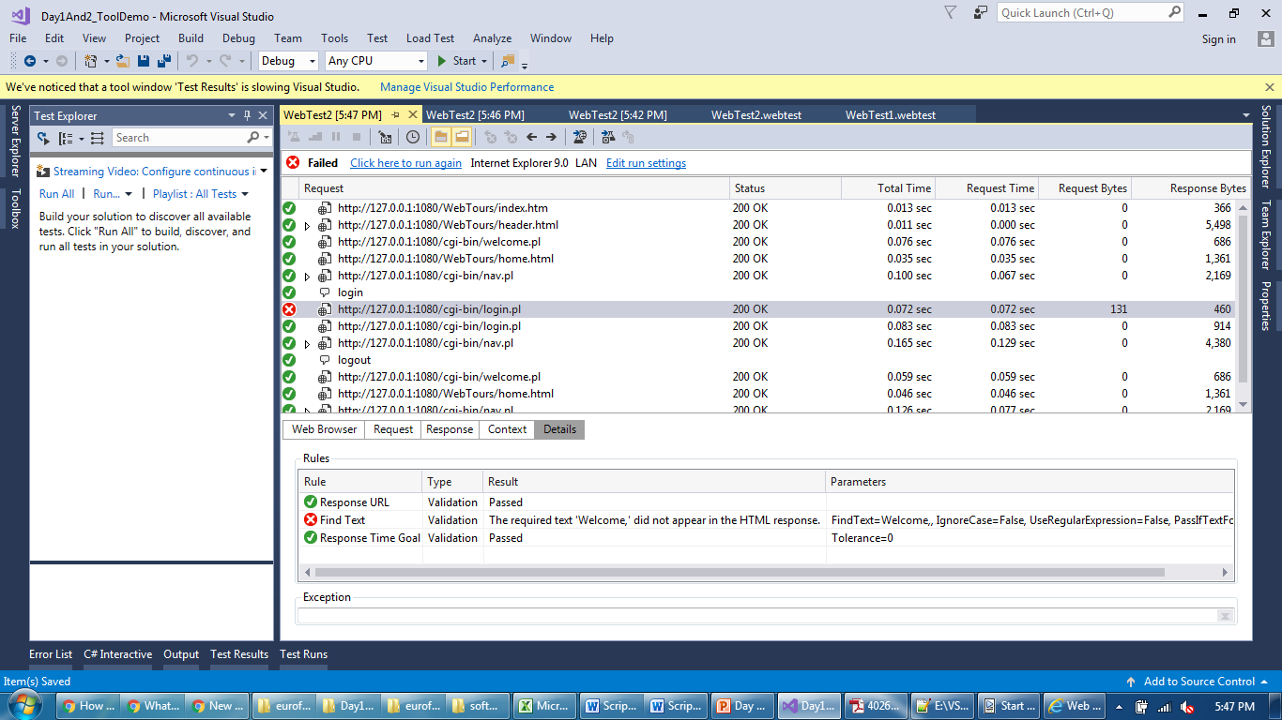
Tool Overview
Now script failed but “Run Script” didn’t stop at error

Slide 38
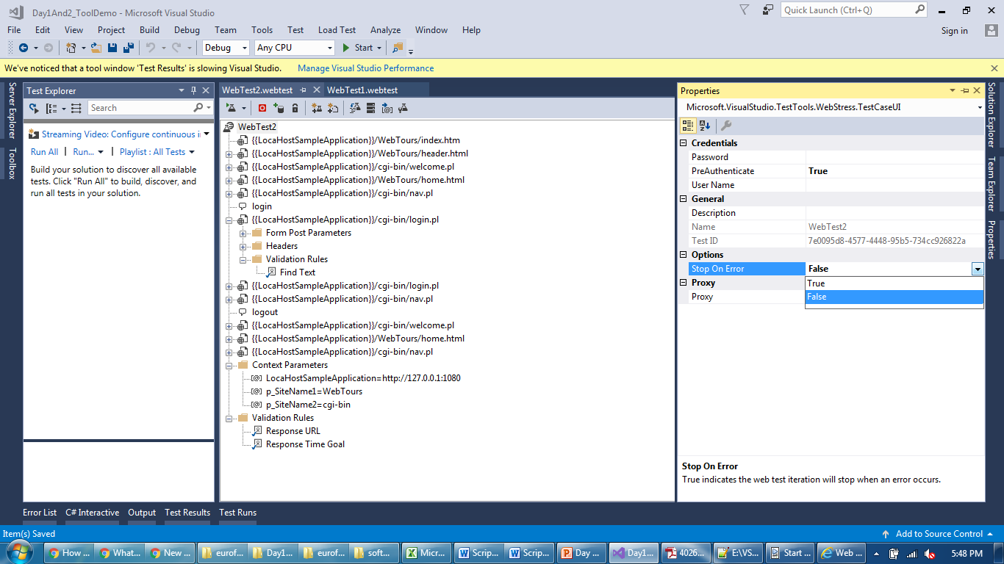
Tool Overview
Now script will fail at error

Slide 39
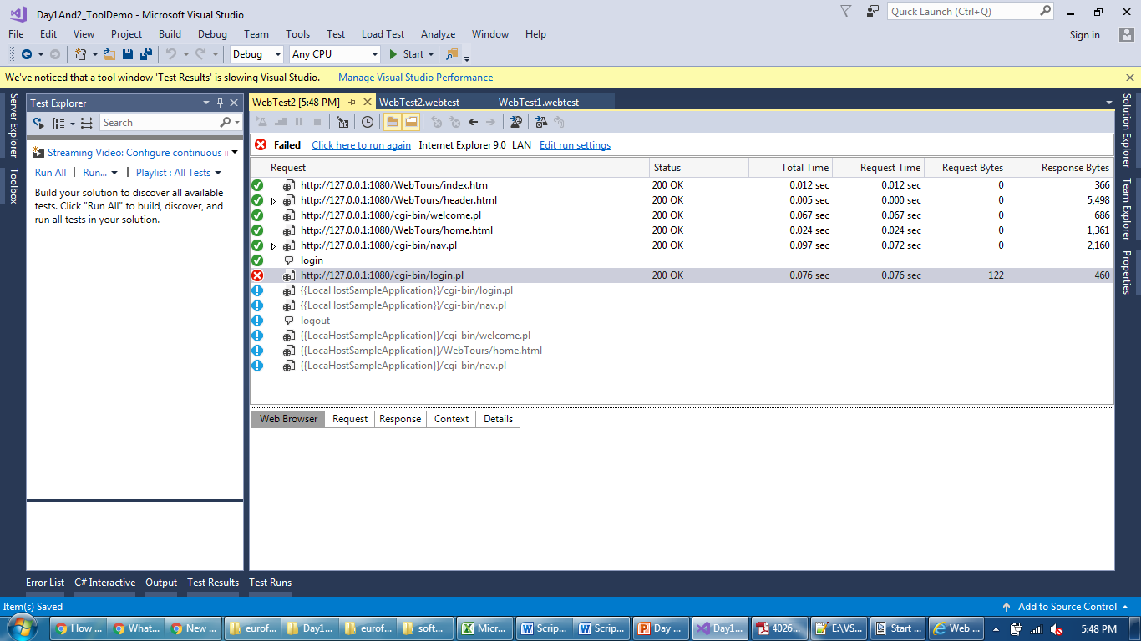
Tool Overview
Script failed and didn’t continue run after that

Slide 40
Thank You

